Slide 1
‘Room at the bottom’
Intreerede prof.dr. Bernd Rieger
Hoogleraar Imaging Physics
29 September 2017

Slide 2
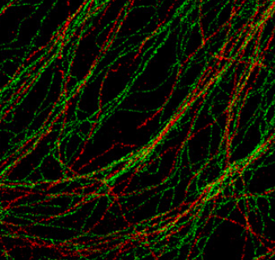
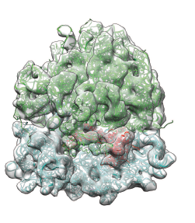
Computational Microscopy
Super-resolution
Overcoming physical limits in
image formation
20 nm
Electron Tomography

Slide 3
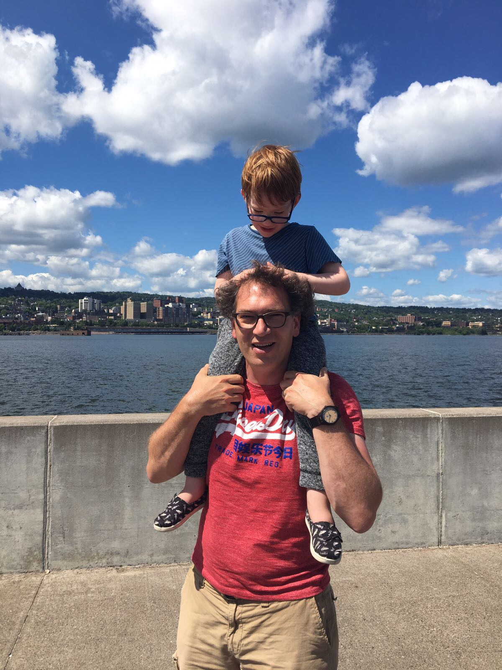
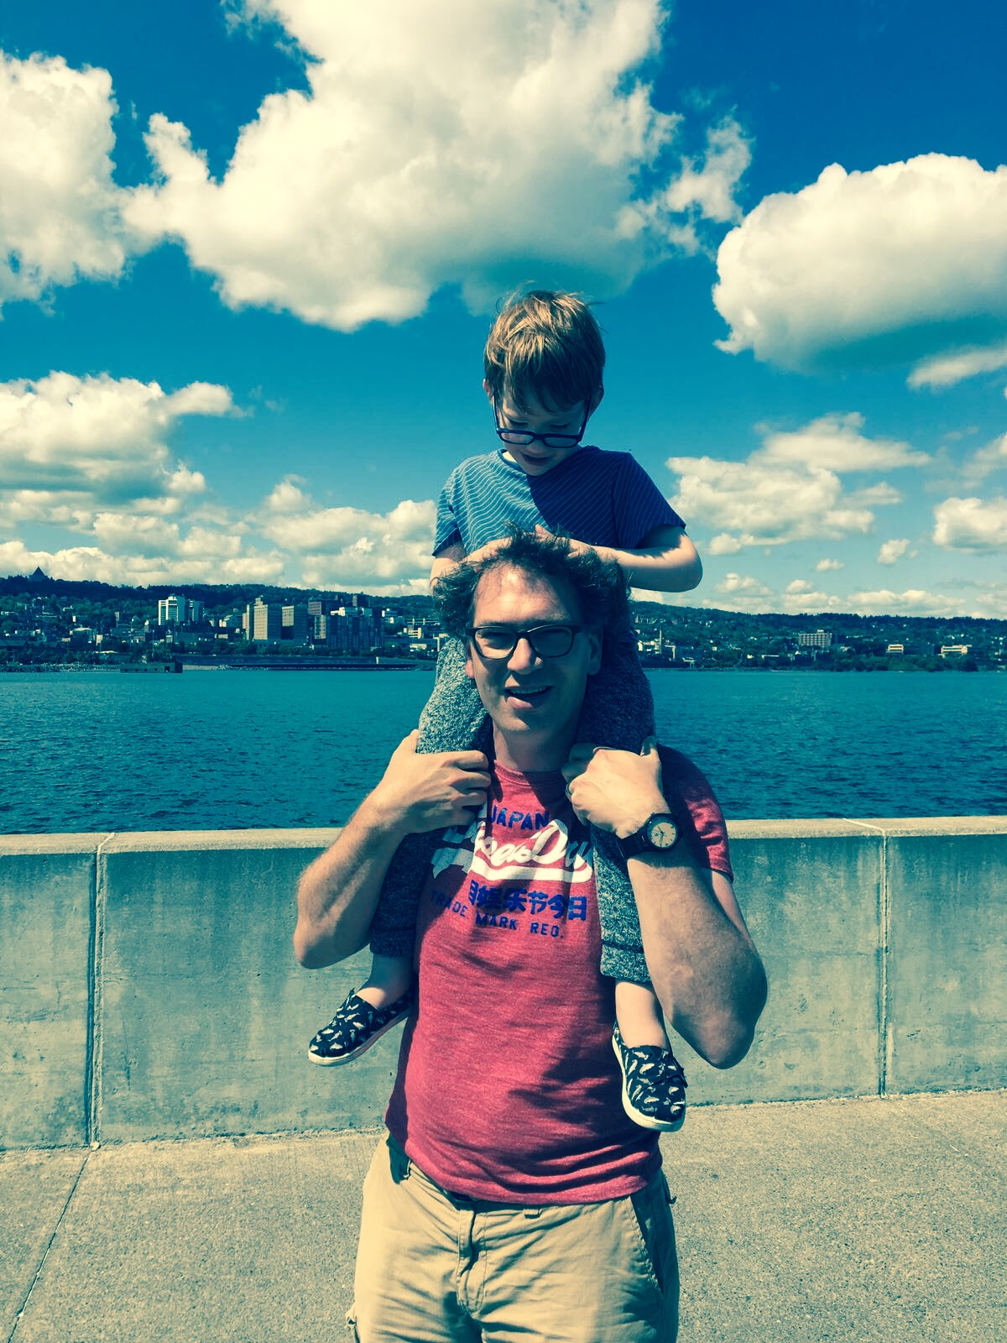

Slide 4
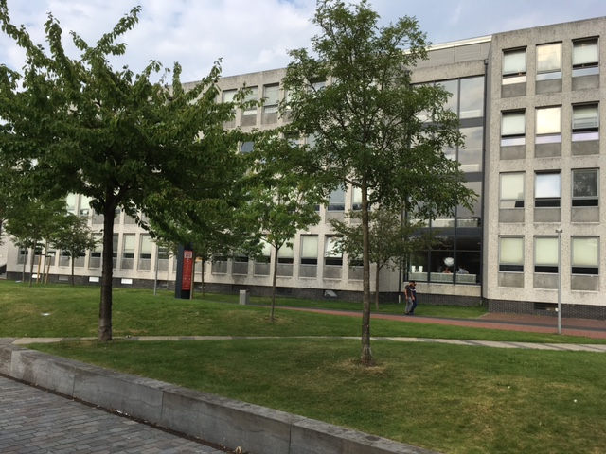
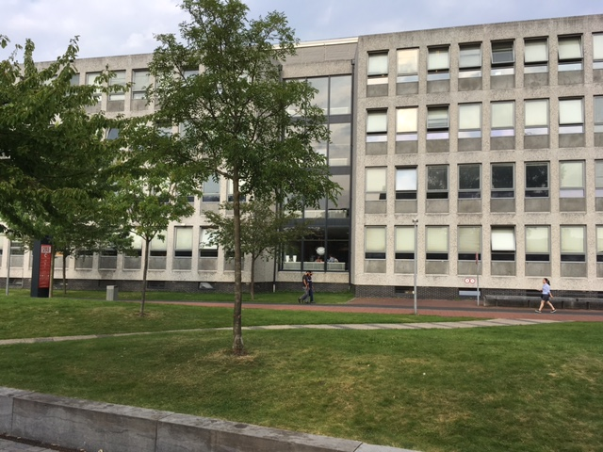
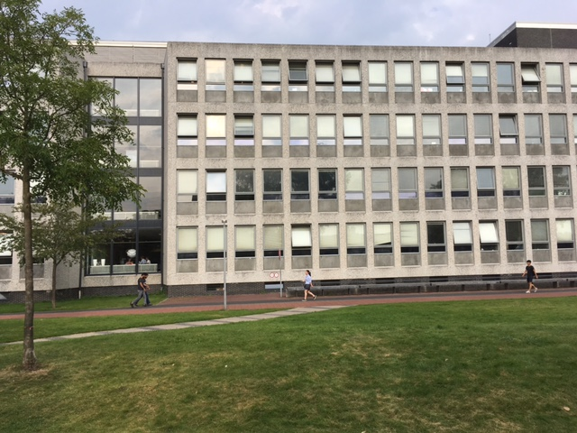
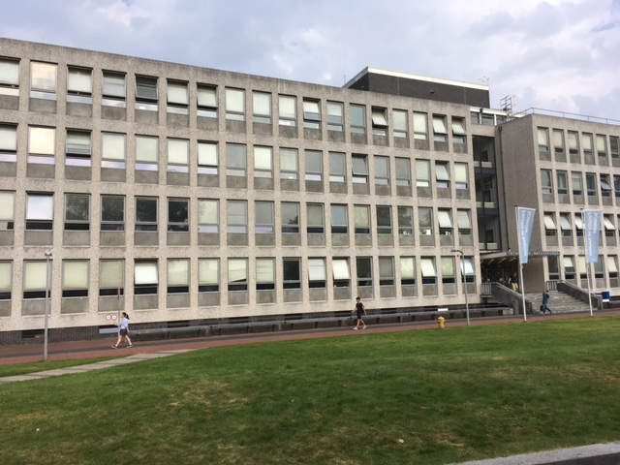
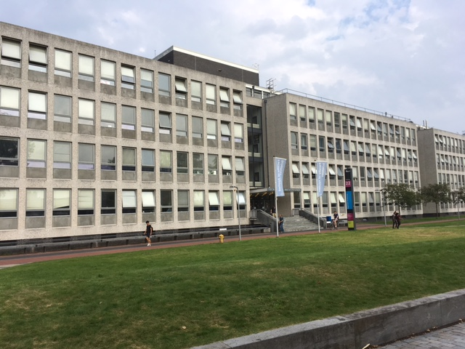
Applied physics building

Slide 5
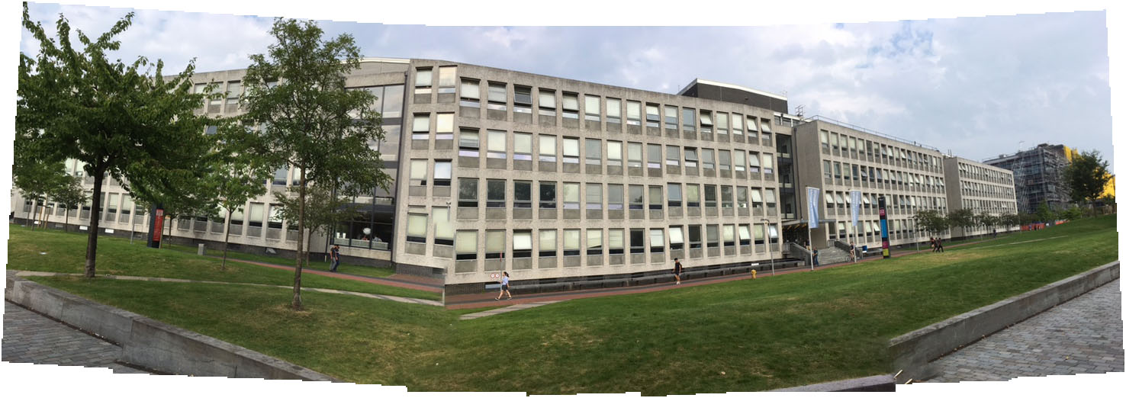
Applied physics building
Basic stitching of a series of images using only translations and rotations

Slide 6
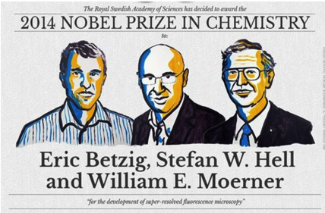
Computational Microscopy
Super-resolution
Overcoming physical limits in
image formation

Slide 7
Animation 350 years microscopy in Delft

Slide 9
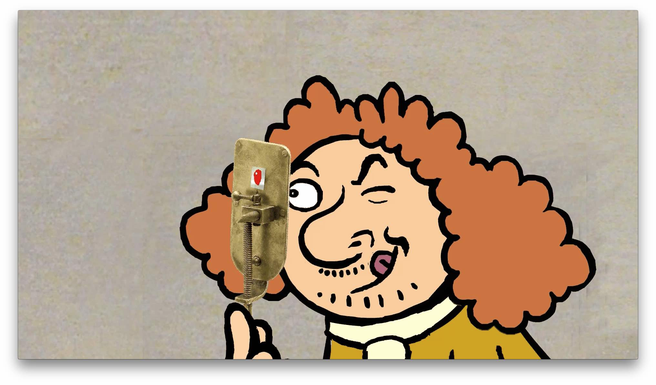
Antonie van Leeuwenhoek (1632 - 1723)

Slide 10
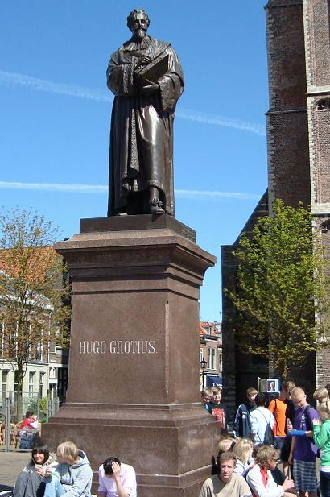
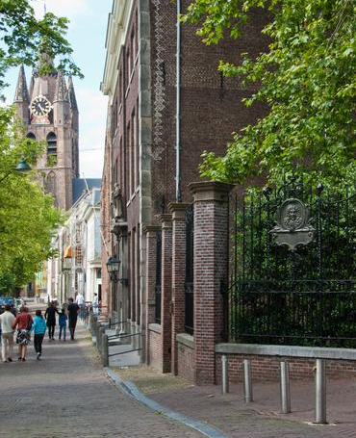
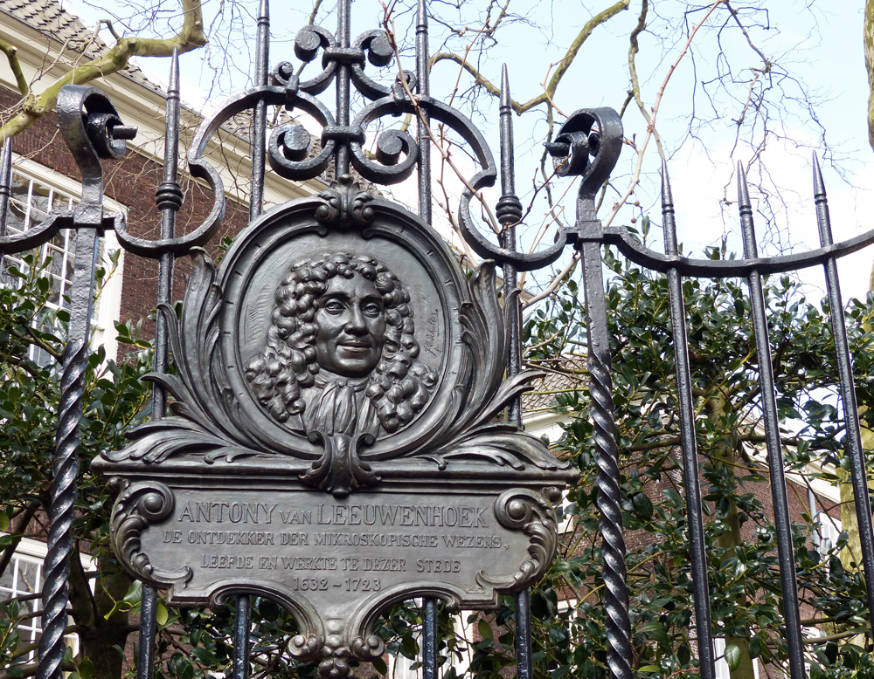

Slide 12
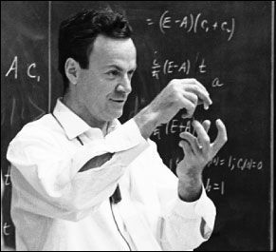
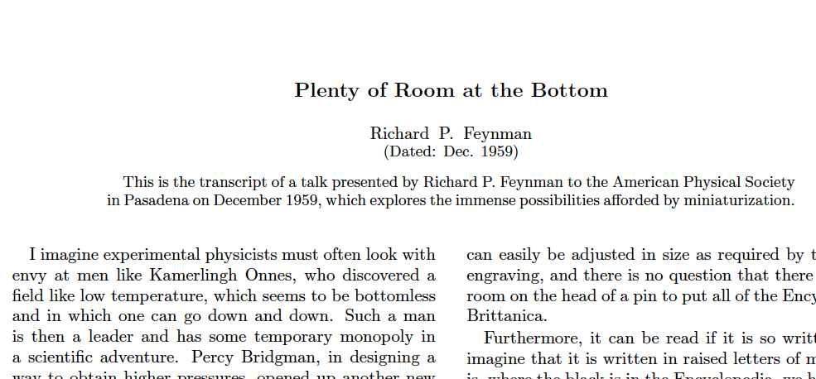

Slide 14
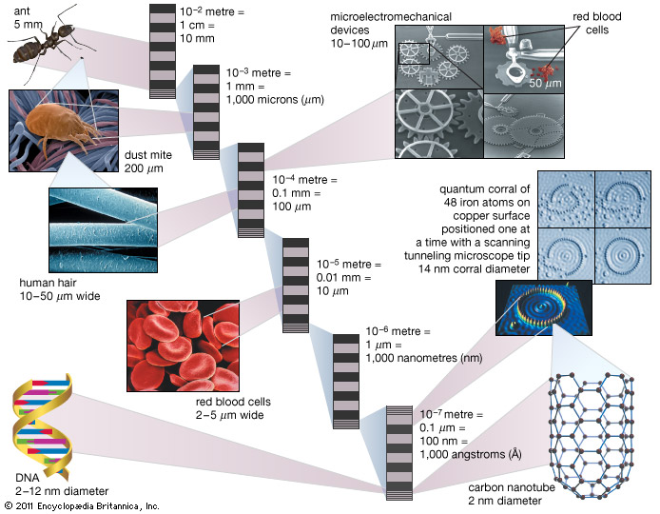
Light microscope
10x better with light
Notes:
Animation of relevant pictures, image too compicated.

Slide 15
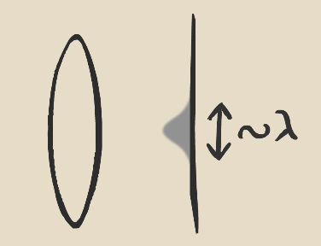
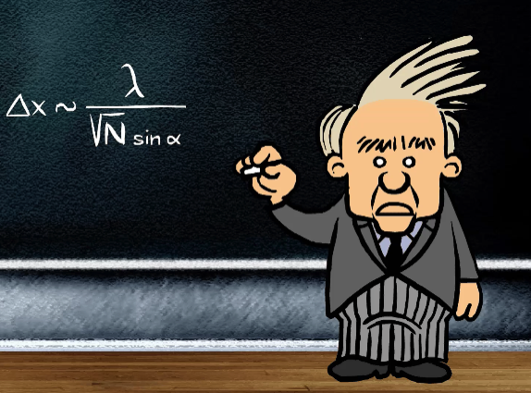
Single molecule localization microscopy
2 μm
10 x
200 nm
time
Zhuang lab, Science 2013
diffraction of light

Slide 16
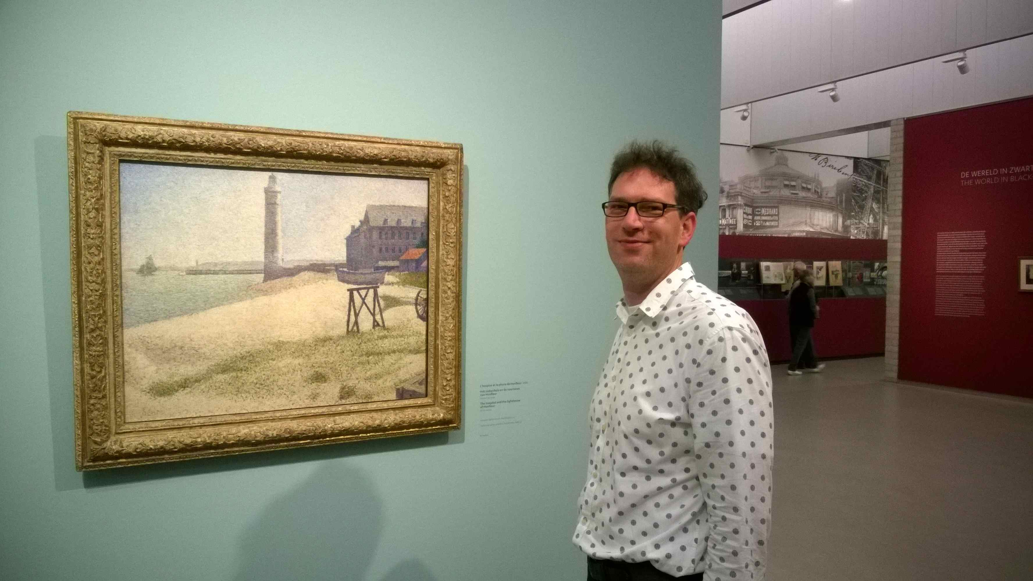
Kröller Müller museum

Slide 17
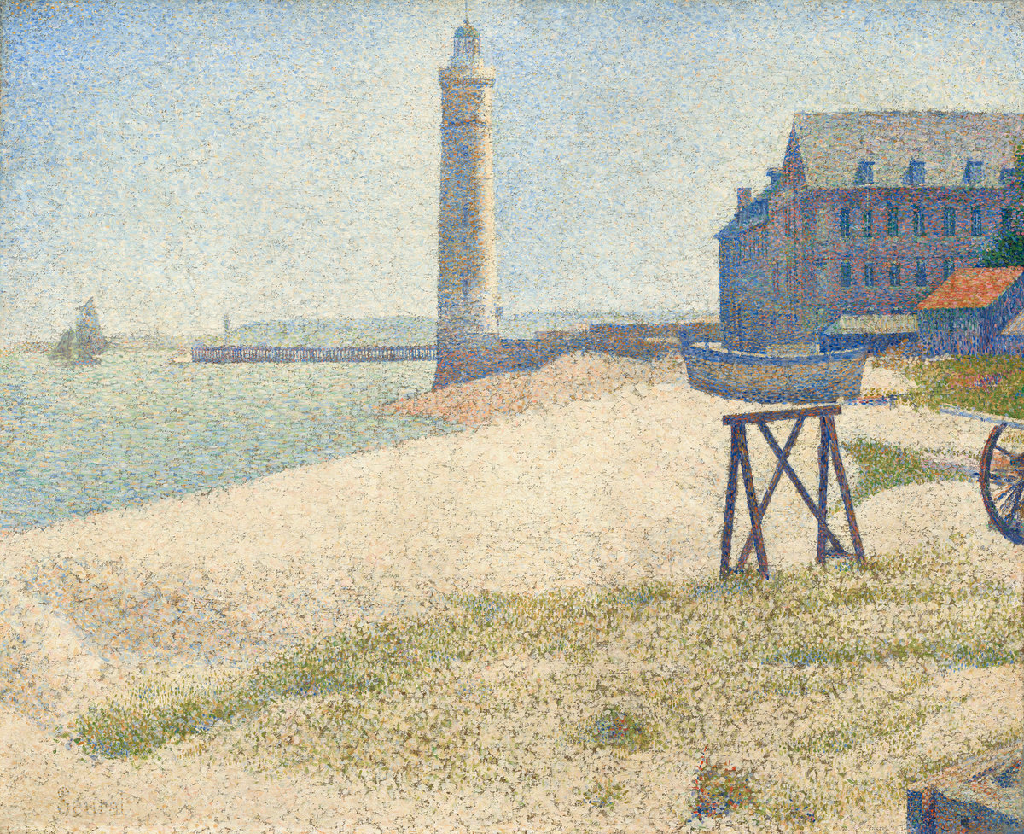
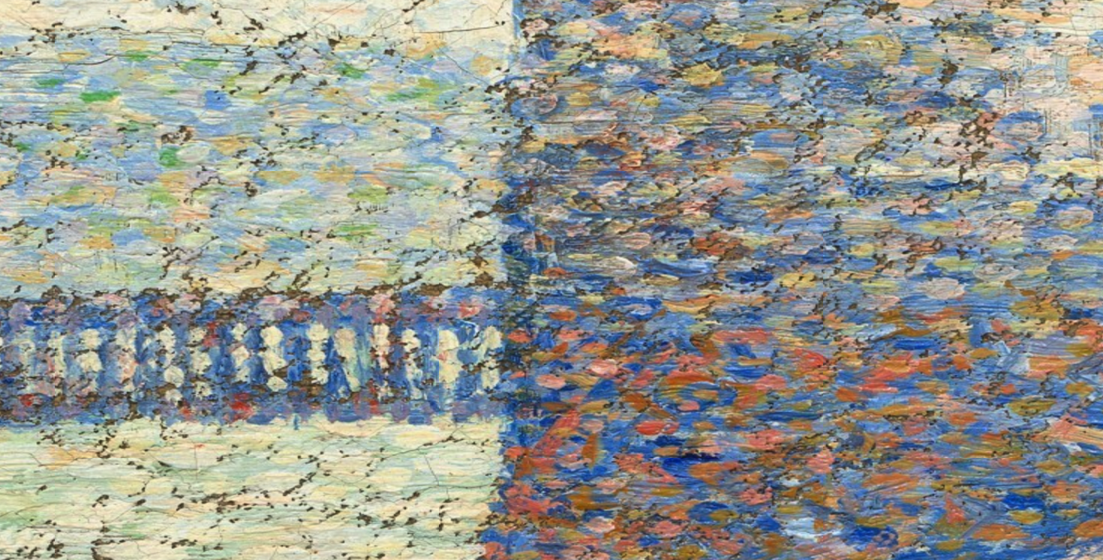
The Lighthouse at Honfleur
Georges-Pierre Seurat (1859-1891)
Notes:
I want to start by showing you a painting by the French painter Georges-Pierre Seurat [Aussprache: Schorsch Piere Soera]. He painted in a technique later termed “pointillism”. If you zoom in very closely you see that he painted the image not by brushes but by putting small dots very close to each other. This technique of image formation is very much related to my research. I will tell you all about that in a minute.
But let me start by telling how I got here

Slide 18
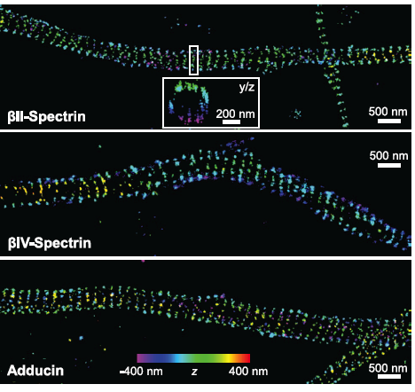
Localization Microscopy & structure in axons
K.Xu, G. Zhong, X. Zhuang, Actin, spectrin, and associated proteins form a periodic cytoskeletal structure in axons, Science, 2013.

Slide 19
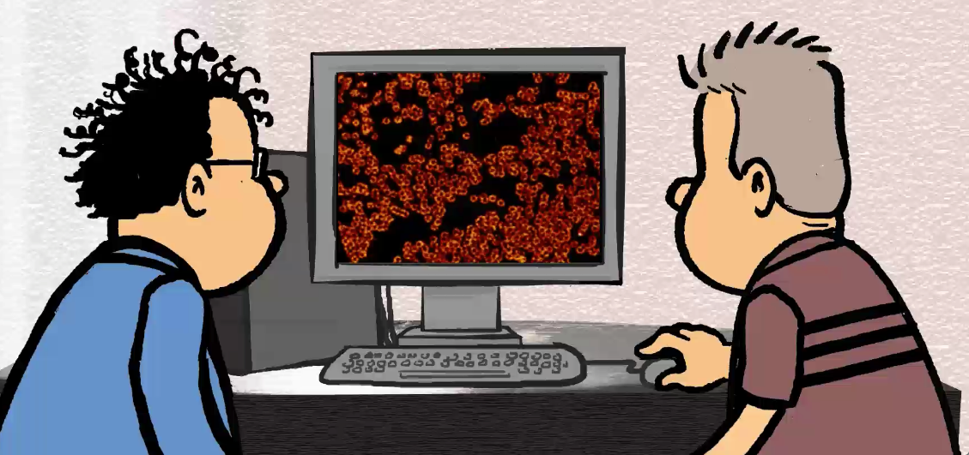
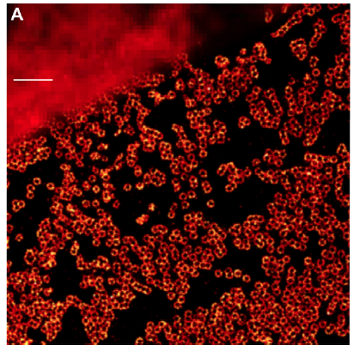
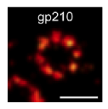
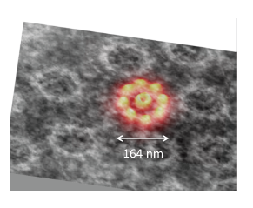
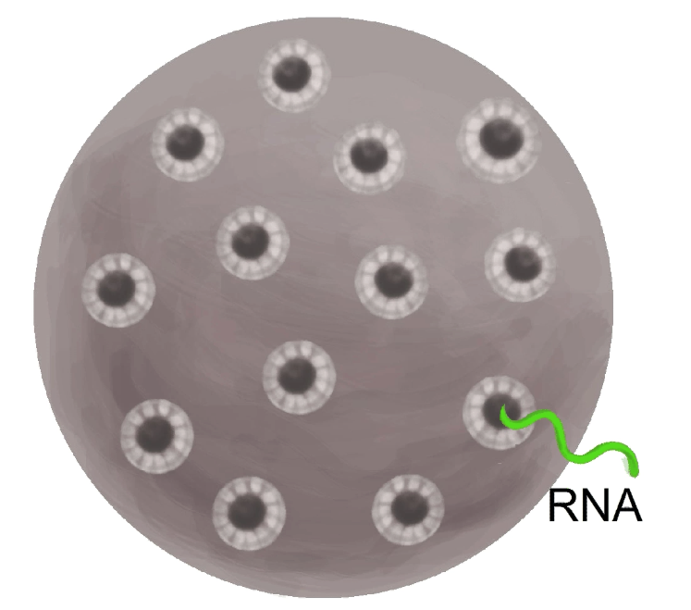
What we can do now
1μm
150 nm

Slide 20
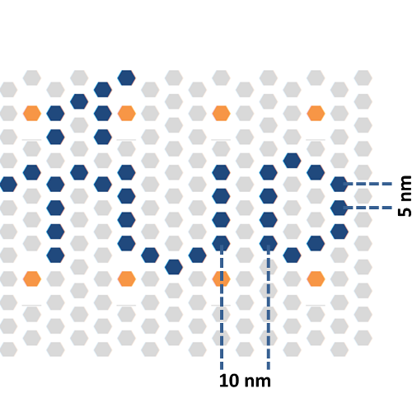
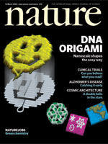
Imaging DNA Origami
Breakthrough by
self assembly
70 nm
2006
f
Notes:
- Add a unique scale bar to all of the figures

Slide 21
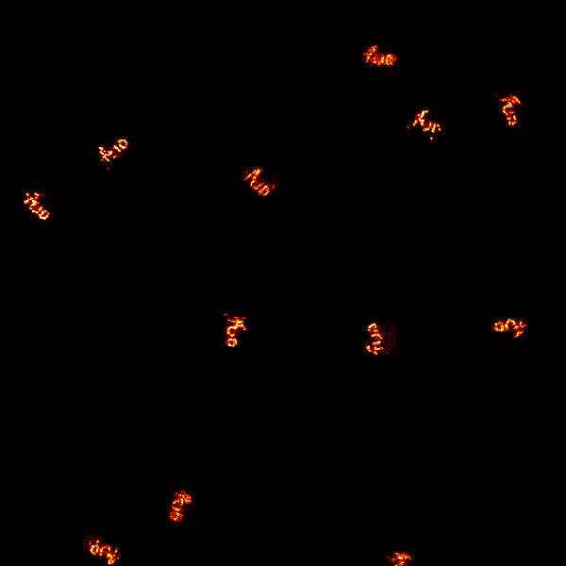
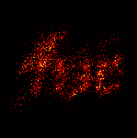
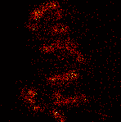
Imaging many TUD logos
100 nm < λ
Notes:
- Add a unique scale bar to all of the figures

Slide 22
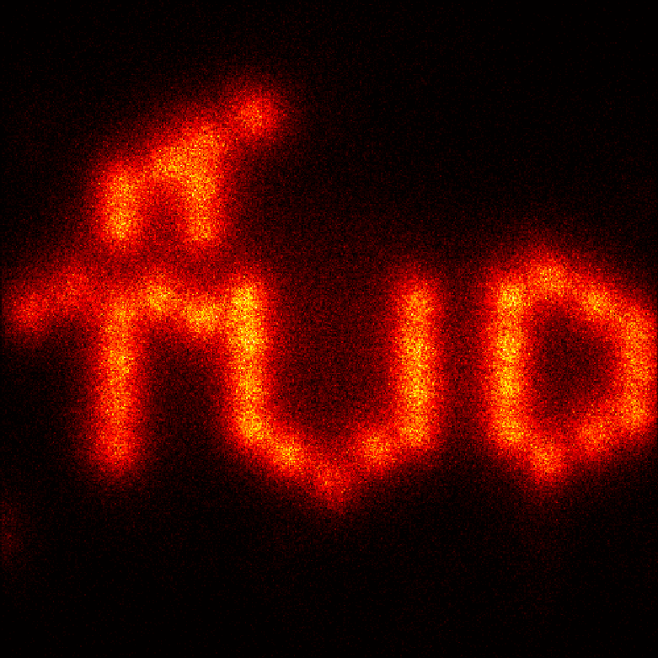
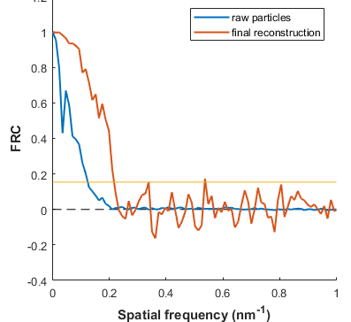
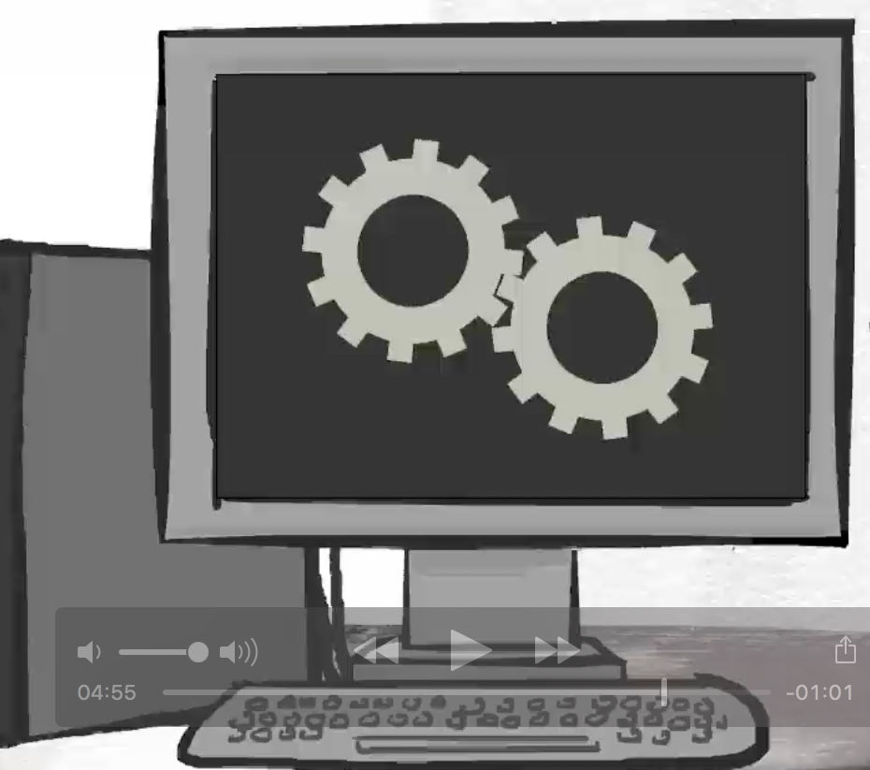
Data fusion TUD logos
Combining 500 TUD’s
10 nm
4 nm resolution in a light microscope! Wavelength/140!
Notes:
- Add bluured image through normal micorcope.

Slide 23
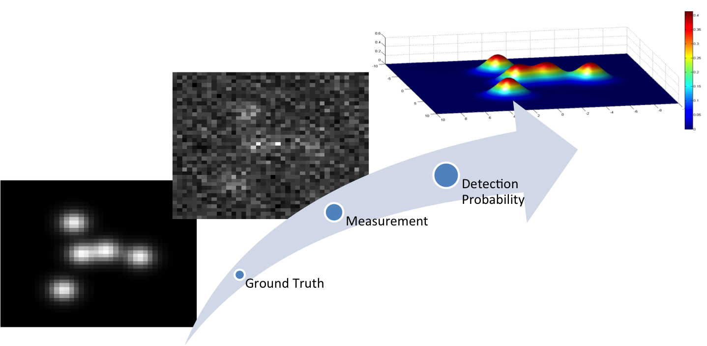
Detection of single molecules

Slide 24
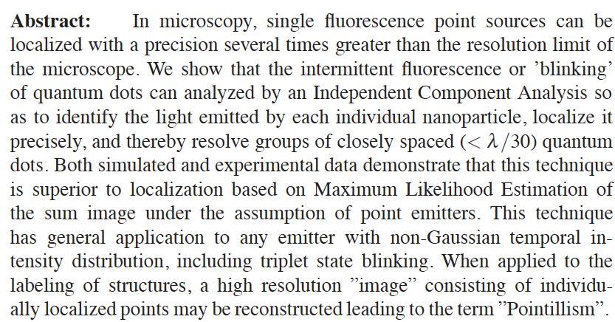
“Je gaat het pas zien als je het door hebt.”
(You only see it after you understand it)
Notes:
“Je gaat het pas zien als je het door hebt”

Slide 25
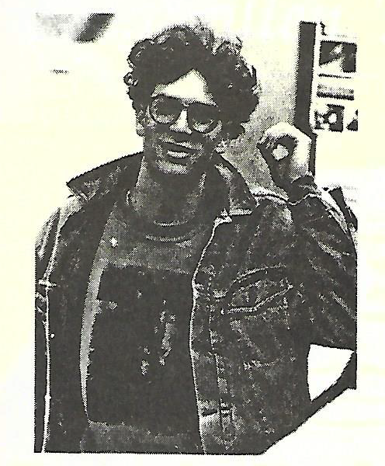
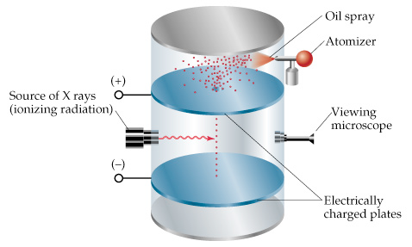
Why Physics?
Milikan experiment
wps.prenhall.com
Abi-Zeitung 1992
Unit charge 1.5924(17)×10⁻¹⁹ C
Now: Unit charge 1.602176565(35)×10⁻¹⁹ C

Slide 26
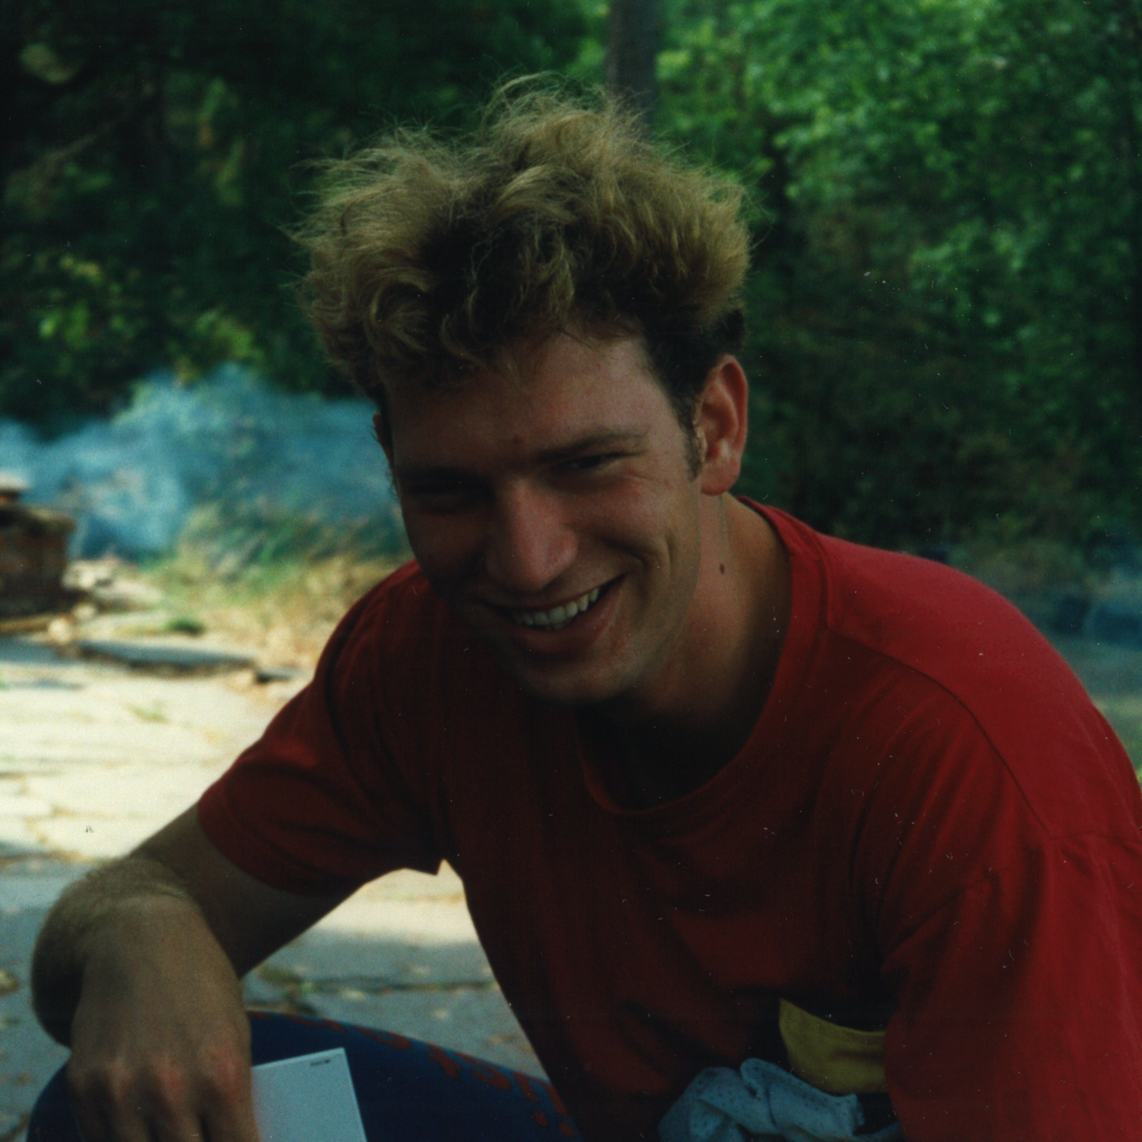
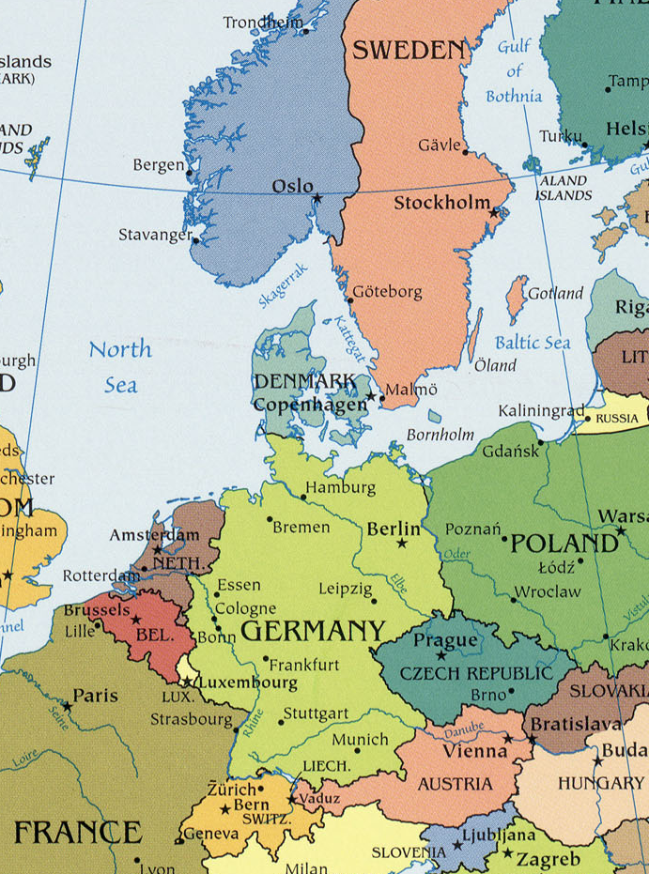
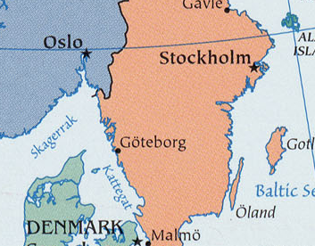
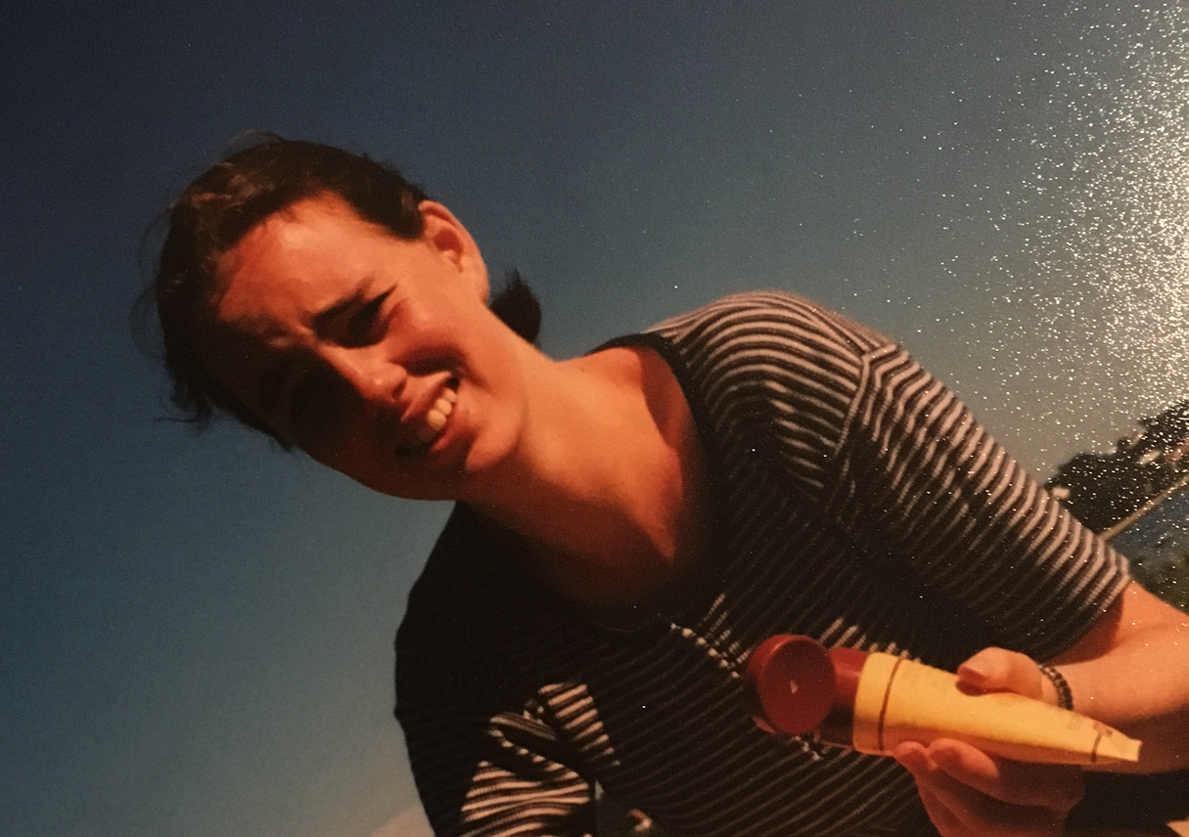
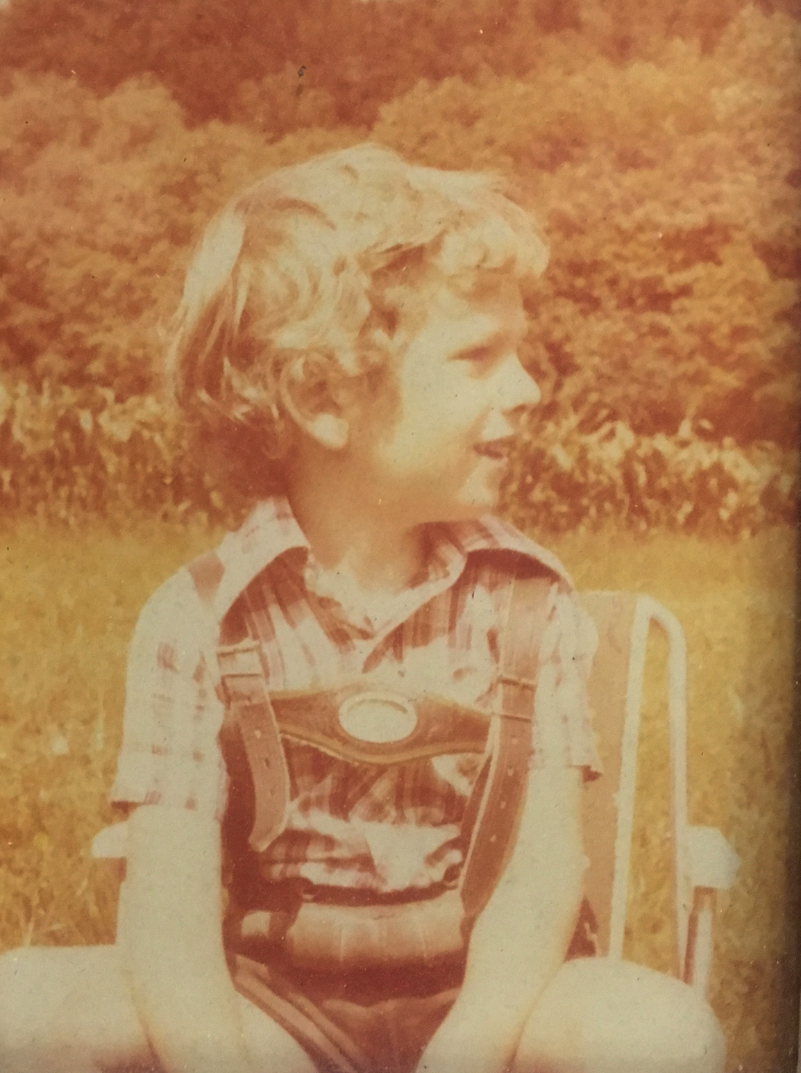
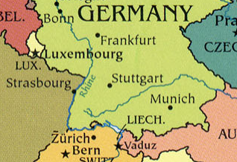
My path to Delft

Slide 27
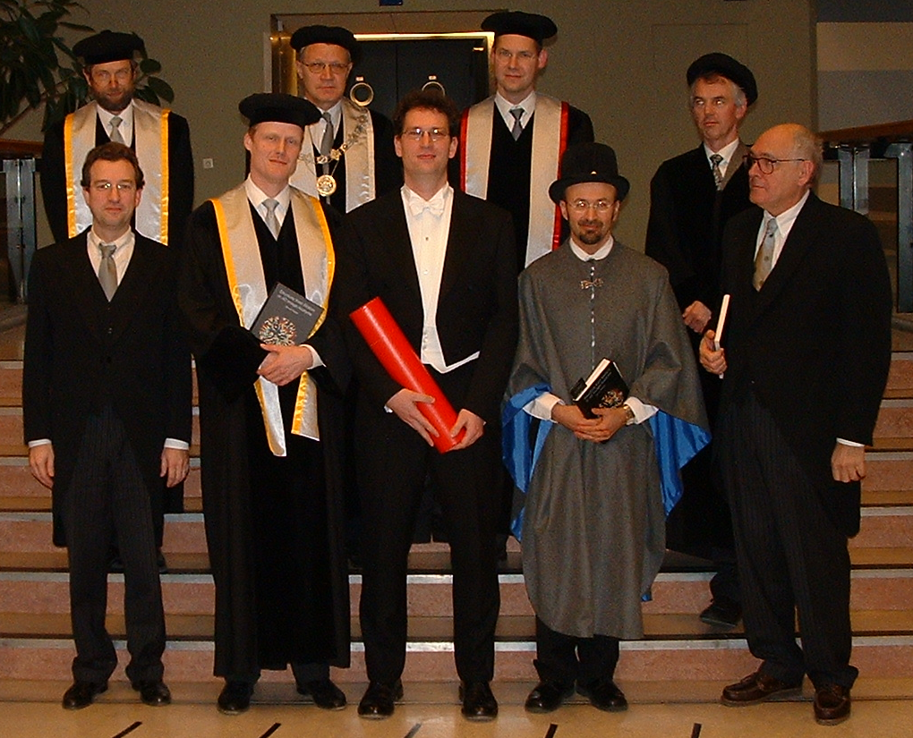
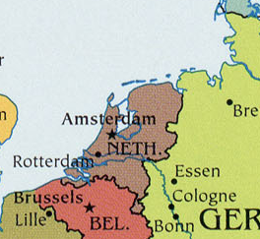
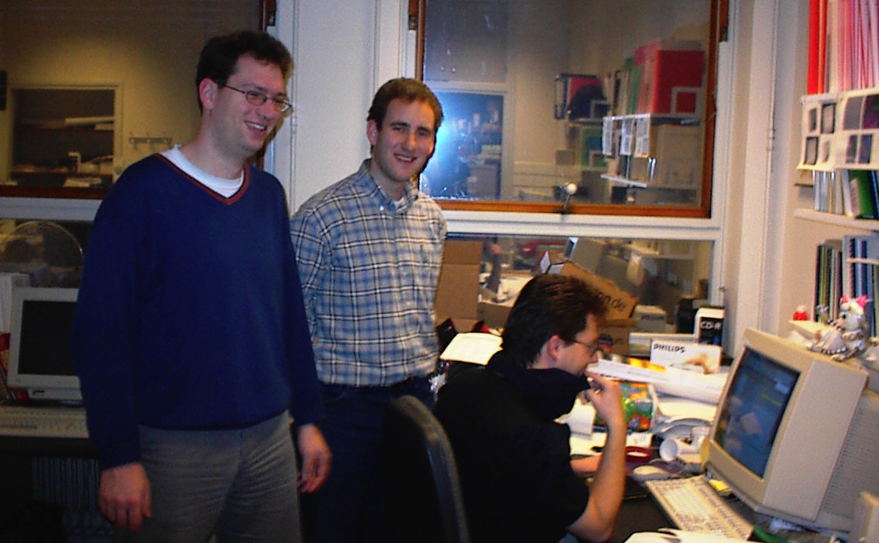
My path to Delft

Slide 28
My path to Delft
Göttingen

Slide 29
My path to Delft
Eindhoven

Slide 30
And to Delft again

Slide 31
Aspects of Dutch culture
“It boils down to that we are autonomous individuals in the Netherlands who have the right to an opinion and to bluntly voice it, such that unreserved solidarity, harmony and courtesy are not leading principles but only obstacles for honesty.
However, all perception of inequality is undesirable at the same time. And anybody who deviates from this happiness of the mean, is as a matter of principle suspect. ”
“But don’t you think that all the conferences, committees and networking is all that exciting for me. The larger the numbers and the larger the homogeneity in these groups the larger the urge to run away screaming.”
Image: zoom.nl
Notes:
How did I become a professor within the Dutch system? In each country it is wise to be aware of the cultural sociological rules of
Keyan Shahbazi in VK 20 juni 2017:

Slide 32
“Fast an extra 100 female full professors in 2017”
Minister Bussemaker
Average age promotion to full professor is 49y (Rathenau Instituut)
Average ~15y for promotion from assistant to full
15 y
Still some losses

Slide 33
Image: ikea.com
Image: zoom.nl

Slide 34
Female Faculty @ Applied Sciences TU Delft
Notes:
11 non dutch
8 dutch

Slide 35
Greg Bokinsky
Martin Depken
Chirlmin Joo
Zoltan Perko
Ekkes Brueck
Iulian Dugulan
Frank Hollmann
Duncan McMillan
Ulf Hanefeld
Jean-Marc Daran
Aljoscha Wahl
Cristian Picioreanu
Stephen Picken
Sasa Kenjeres
Pouyan Boukany
Eduardo Mendes
Bernd Rieger
Florian Bociort
Aurele Adam
Andrea Caviglia
Leonardo Di Carlo
Simon Gröblacher
Gary Steele
Andreas Engel
Lieven Vandersypen
Jian Rong Gao
Anton Akhmerov
Yaroslav Blanter
Yuli Nararov
John Posada
Wilson Smith
Evgeny Pidko
Christophe Danelon
Hyun Youk
Sjoerd Stallinga
Frans Vos
Jeroen Kalkman
Jaap Caro
Nico de Jong
Eric Verschuur
Martin Verweij
Koen van Dongen
Paul Urbach
Pieter Kruit
Jacob Hoogenboom
Kees Hagen
Daan Brinks
Erik Bakker
Ronald Hanson
Teun Klapwijk
Leo Kouwenhoven
Kobus Kuipers
Sander Otte
Peter-Leon Hagedoorn
Fred Hagen
Henk Noorman
Marcel Ottens
Adrie Straathof
Herre van der Zant
Heny Zandbergen
Gerrit Bauer
Jos Thijssen
Paul Alkemade
Bertus Beaumont
Cees Dekker
Timon Idema
Stan Brouns
Jan Leen Klosterman
Martin Rohde
Danny Lathouwers
Dennis Schaart
Niels van Dijk
Stephan Eijt
Freek Beekman
Theo Wolterbeek
Jack Pronk
Robert Mans
Walter van Gulik
Robbert Kleerebezem
Mark van Loosdrecht
Hans Vrouwenvelder
David Weissbrodt
Volkert van Steijn
Luuk van der Wielen
Geert-Jan Witkamp
Ruud van Ommen
Rienk Eelkema
Freek Kapteijn
Michiel Kreutzer
Ferdinand Grozema
Ger Koper
Bernard Dam
Lauren Siebbeles
Jan van Esch
Marcel de Puit
Ernst Sudhoelter
Wolter Jager
Chris Kleijn
Rob Mudde
David Vermaas
Peter Hamersma
Fokko Mulder
Henk Nugteren
Andre de Haan
Gabrie Meesters
Michiel Makkee
Pieter Swinkels
Tom Savenije
Arjan Houtepen
David Vermaas
Peter Steeneken
Male Faculty @ Applied Sciences TU Delft

Slide 36
Salary pay scales Dutch Universities 2017
Early to late 30’s
Starting salaries
assistant professor
In euros before tax, paid ~14 times a year
Notes:
Starting salaries: Bernd 11/4, Daan 11/5, Aurele 11/1, Koen 11/3, Jacob 11/6, Jeroen 11/9, Elizabeth 11/7
Mean: 4086+-334 (7 persons Imphys)

Slide 37
Room at the bottom
Spatial
Resolution
Cube of 100 μm @ 1nm @ 1000 fps
10¹⁵ pixel/volume (peta)
10¹⁸ pixel/second (exa)
Image
Quality
Signal to
noise ratio
Temporal
Resolution

Slide 38
Room at the bottom
Do more with less
Away from the 1000 suns
Move away from overexpression of proteins
Inclusion of more prior knowledge ala Minflux (Stefan Hell)
Data fusion of indicial particles
Imaging with N entangled photons
Don’t be afraid of the noise

Slide 39
Thanks
for the Science
Lucas van Vliet
Tom Jovin
Sjoerd Stallinga
Notes:
Tom Jovin: next to the time spent in at the MPI in Goettingen. Tom’s lab has produced more professors at Dutch universities than most other labs anywhere! Next to me here, Vinod Subramanian now at VU, Alessandra Cambi in Nijmegen and Dorus Gadella at the Uva (where the latter is the only Dutch).

Slide 40
Thanks
for the Education, Science & Inspiration
Ted Young
Piet Verbeek
Micheal van Ginkel
Frans Vos
Cees Dekker

Slide 41
Thanks
for the possibility of an education
The German social security system in the 1990s

Slide 42
Thanks
for the fun

Slide 43
Thanks
for the support
Marion
Karin
Ron
Wim
Annelies
Liesbeth
Ronald

Slide 44
Otto & Moritz
Manon

Slide 46
Doe maar normaal dan doe je al gek genoeg
Hoge bomen vangen veel wind.
Het hoofd niet boven het maaiveld uitsteken.
4-3-3
Geen gezeik iedereen rijk (F. Jacobse & Tedje van Es)
VVD 2017

